Slide 1


Lecture N9 Philosophy of values. Ethics.

Slide 2
1. The Subject of Axiology

Slide 3
Value is a philosophical category that designates objects, phenomena, their properties, as well as abstract ideas that embody social and cultural ideals and thus act as a standard of what is due.
Value for a person is everything that has a certain significance for him, personal, social or cultural meaning.
The quantitative characteristic of this meaning is evaluation.

Slide 4
The philosophical doctrine of values is called AXIOLOGY (from the Greek axios, meaning values, and logos, teaching). This is a special branch of philosophy, where the problem of values is comprehensively investigated. From antiquity to the present day, there is no unity in the views of various philosophical schools and trends on the main question of axiology:
whether value is an attribute of a particular thing or is it the result of its evaluation by a person or society depending on its usefulness. In other words, or:
a) value is something objective, existing in itself;
b) value is a subjective value judgment of an arbitrary nature.

Slide 5
In various currents of modern philosophy, the nature of values is understood ambiguously; There are different points of view:
a) value is understood as an object that has any benefit and is able to satisfy a particular human need;
b) value is understood as an ideal (French - a model, something perfect, the highest goal of aspirations);
c) value as a norm (from the Latin norma – guiding principle, rule, model);
d) value – as the significance of something in general for a person, any social group or society.

Slide 6
The doctrine of values (axiology) did not immediately become the property of philosophers, but only after it was possible to distinguish between the concepts of being and good. This happened in the philosophy of Kant, who opposed the sphere of morality to the sphere of nature, and practical reason to theoretical reason.
Some philosophers saw the source of value in the subject, in the will, in feeling, in the peculiarities of the transcendental subject. The neo-Kantians discovered the source of values in the rational will, which ensures the acts of choice.
F. Brentano accused the neo-Kantians of subordinating the concept of values to reason and believed that the source of values is emotional acts of love and hatred.
Materialist philosophers saw the source of values in realities independent of the subject, in material goods. Marxism brought to the fore the values of social order.
Often the problem of values is understood in the most general terms, then TRUTH, GOODNESS AND BEAUTY ACT AS VALUES. In greater detail, economic, political, aesthetic, moral, and religious values are distinguished. M. Scheler believed that the rank of a value is higher, the more durable it is and the greater the satisfaction it causes. In this regard, he put in the first place the value of the pleasant, associated with the satisfaction of sensual inclinations of a person. Differences in understanding do not exclude, but complement the general concept of values, which are the result of evaluation – the awareness of things and their properties as necessary and important for a person.

Slide 7
2. Classification of values

Slide 8
The diversity of human needs and interests is expressed in a complex system of classification of values. All values are different: 1. According to the time of their existence: - concrete-historical (certain values were perceived differently at a particular time or era); 2. by content (correspond to subsystems of society) and act in the form of three main groups: a) material (economic); b) socio-political; c) spiritual.
Material values include: production and consumption or utilitarian; relations to property;
Social and political values: ideas about social justice; ideas about freedom; ideas about human rights; ideas about the role and functions of the state; ideas about the role of political parties, movements, associations, etc.
Spiritual values: moral (ethical); legal and political; Aesthetic; Religious; epistemological. 3. by carrier: a) universal; b) national; c) group; d) individual or personal; 4. by significance: a) absolute value; b) higher; c) specific, etc.

Slide 9
Despite different approaches to the differentiation of values, all of them are closely interrelated, united and form an integral system. At present, within the countries that are guided by the principles of Western civilization, the absolute value in the system of values is considered to be the HUMAN himself, his life and health. All the great thinkers of different times and peoples have emphasized this.
The most concise and succinct expression in "Aphorisms of Worldly Wisdom" was made by Arthur Schopenhauer (1788-1860), a German philosopher.
"Nine-tenths of our happiness is based on HEALTH. With it, everything becomes a source of pleasure, while without it absolutely no higher good can give pleasure; Even subjective goods: the qualities of the mind, soul, temperament - weaken and freeze in a sickly state... Hence the conclusion that it would be the greatest folly to sacrifice one's health for anything: for the sake of wealth, career, education, fame, not to mention sensual and fleeting pleasures; or rather, all this is worth sacrificing for the sake of health"
It is a person who is an intrinsic value. Posing the question of values outside of man is meaningless.

Slide 10
The main types and role of values in society. All values are divided into two large classes:
1. by carrier; According to the subject, i.e. the carrier, values can be of two types:
supra-individual (group, national, class, professional, demographic, specific, etc.); individual, subjective-personal.
2) by the form of existence. According to the form of being, all values can also be of two types:
a) material (objective);
b) ideal (spiritual);

Slide 11
The true question of philosophy is the clarification of the relationship between supra-individual and individual values.
First, what comes first, individual or social values? Secondly, what comes out of what - individual from social or social from individual? However, most philosophers believe that these questions are far-fetched.
Social values are predetermined by the consciousness of an individual: a) they are formed and exist before his birth, b) they continue to exist after his death. In this sense, they appear for the individual as an objective reality that influences the personality and forms its core. Therefore, supra-individual values are primary in the formation of personality, they contribute to its adaptation to the social environment, to occupy a certain place in society. Thus, social values are assimilated by a person in the process of socialization.
Ideals, norms, means and goals, acting as values of a person, form a system of his value orientations, the core of his consciousness and are the impulse of his actions and deeds. But the formation of personality takes place within the framework of social groups, communities with their specific set of values. Therefore, a person is forced to share their ideals and values, or look for compromises. Consequently, individual values are formed under the influence of the individual's supra-individual and life experience. Supra-individual values always have an impact on the behavior of a person, regardless of whether certain phenomena are recognized as values or not. Ideas about the system of values constitute the value orientations of the individual. Value orientations are supported and characterized by the individual's life experience and the totality of his experiences.

Slide 12
Material (objective values) are natural goods, social benefits, cultural heritage, objects of religious worship, etc., which exist in the form of specific things, phenomena in human society. Objective values are the products of the purposeful activity of members of society, which correspond to their ideas of perfection. They always act as objects of human needs and interests.
Ideal (spiritual values) are social ideals, attitudes and assessments, norms and prohibitions, goals and projects, standards and principles of action expressed in the form of normative ideas about virtue, good and evil, beautiful and ugly, just and unjust, lawful and illegal, etc.
Spiritual values always perform a double function: first, they are an independent sphere of values; secondly, they act as a criterion for evaluating objective values.

Slide 13
Spiritual values are heterogeneous: a) in content; b) by the functions performed; c) by the nature of the requirements for their implementation, values can be:
First, rigidly programming goals and methods of people's activities (standards, rules, canons, standards, etc.).
Secondly, more flexible, acting in the form of an algorithm of culture, representing freedom in the realization of values (norms, tastes, ideals, etc.)
Norm is an idea of optimal and expedient activity, dictated by uniform and stable conditions. Norms include: 1) a form of uniformity of actions; 2) a ban on other options for behavior; 3) the optimal variant of the action in the given social conditions (sample); 4) assessment of the behavior of individuals, warning against possible deviations from the norm.
Normative regulation permeates the entire system of human activity and relations. A condition for the implementation of norms is a system of their reinforcement, which involves public approval or condemnation of an action.
Ideal is the idea of the highest norm of perfection. It performs a regulatory function, serving as a vector in determining strategic goals, to the implementation of which a person is ready to devote his entire life.
The ideal is formed in the consciousness of the individual and is a concentrated expression of spiritual values
.

Slide 14
Morality occupies a special place in the system of values:
Moral values regulate relationships in society; They are used as evaluation criteria in all areas of human activity.
The formation of moral notions, norms, principles, traditions, which initially became the only regulator of human relations, is a long, complex and contradictory process.
Moral ideas of a person, formed over the centuries, are reflected in such categories as
Good, Evil, Justice, Conscience, Duty, Happiness, Love, etc.

Slide 15
3. Ethics is the philosophy of morality

Slide 16
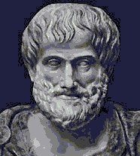
Title: Ethics (Latin word: ethica; derived from the Greek word: ηθικός – relating to disposition, character, custom, habit).
As a term and a special systematized discipline, ethics goes back to Aristotle (IV century BC).
It is first found in the title of all three of his works devoted to the problems of morality "Nicomachean Ethics", "Eudemian Ethics", "Big Ethics".

Slide 17
Ethics was singled out as a special discipline by Aristotle, who introduced the term itself into the title of his works: "Nicomachean Ethics", "Great Ethics", "Eudemian Ethics".
He divided/classified all sciences into three large groups or categories:
theoretical (speculative), practical creative (creative).
Aristotle attributed philosophy, mathematics and physics to the first, the second - ETHICS and politics, and the third - arts, crafts and applied sciences.

Slide 18
THE MAIN TASKS OF ETHICS:
to describe morality – its history, today's norms, principles and ideals – what is called the moral culture of society;
to explain morality — to analyze the essence, structure, mechanisms of the functioning of morality in its "ought" and "existing" versions;
to teach morality - to give people the necessary knowledge about good and evil, contributing to the self-improvement of a person and the development of his own strategy and tactics of "right life".

Slide 19
Ethics is related to philosophy by its generic affiliation, constituting its normative and practical part. At the same time, it is essentially connected with metaphysics, and this, first of all, expresses its philosophical character. Morality claims to be absolute, to be the ultimate value support of human existence, so the doctrine of morality is always interconnected with the doctrine of being;
According to the nature of the interpretation of the foundations of morality, all philosophical moral systems can be divided into heteronomous and autonomous.
The essential peculiarity of ethics lies in the fact that, being a science of morality, it is at the same time in a certain sense a part of the latter. Separating ethics as a practical philosophy from theoretical philosophy (physics, mathematics, the doctrine of first causes), Aristotle meant that it sets the ultimate goal basis of human activity, determining what it is ultimately aimed at and what its perfection (virtue) consists in.
Thus, ethics is studied not in order to know what virtue (morality) is, but in order to become virtuous (moral). !!!!!!!!!!!!!

Slide 20
PROBLEMS OF ETHICS
With all the doctrinal diversity of ethical systems, all of them, in one way or another, deal with three main thematic complexes:
What should I do?
In order to answer this question, which constitutes the differentia spezifica of ethics, it is necessary to investigate what the meaning of life is, what are good and virtues as distinct from evil and vices, what actions are subject to ethical imputation, and how free will is possible.
How can I combine the moral motive (the desire to follow duty) with diverse interests, the natural desire for happiness?
This question presupposes consideration of what happiness is, what kind of life can be considered happy, which of the ways of life is more preferable from this point of view, what are the specific duties of the individual in relation to his various natural and socially conditioned goals, what qualities he should cultivate in himself.
How can my good be reconciled with the good of others, or how can the moral autonomy of the individual take the form of universally valid norms?
By posing the question in this way, ethics is directly linked with the philosophy of history, with the idea of a perfect social order. It develops a number of concepts (mercy, justice, friendship, solidarity, and others) that set the moral vector for social institutions and relations.

Slide 21
Any developed ethical system includes a more or less detailed program of behavior designed to implement a way of life that allows you to remove the contradictions that tear individuals apart and is recognized by them as morally worthy. The normative certainty of these programs is one of the important features of their classification. According to this criterion, it is possible to distinguish such varieties of ethics as ethics of HEDONISM, EUDEMONISM, STOICISM, SENTIMENTALISM, CONTEMPLATION, UTILITARIANISM, SKEPTICISM

Slide 22
4. History of Ethics

Slide 23
In the beginning, ETHICS meant life wisdom, practical knowledge of how to behave. The oldest ethical norm of human behavior is the "golden rule" of morality
The "Golden Rule" is already found in the early written monuments of many cultures (in the teachings of Confucius, in the ancient Indian Mahabharata, in the Bible, in Homer's Odyssey, etc.) and firmly enters the consciousness of subsequent epochs.
The Golden Rule of Morality: "(Don't) act toward others as you would (not) want others to do toward you."

Slide 24
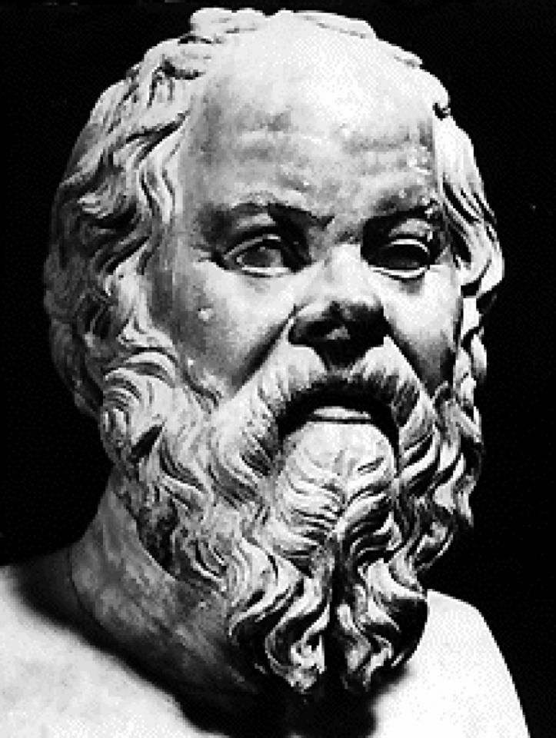
Socrates develops a doctrine – ethical rationalism
Socrates, in contrast to the sophists, believed that all private opinions about the good are relative in comparison with the true concept of good.
The task of the individual is to "know himself", i.e. to move from "opinions" to knowledge about the good, which is acquired through reason.
The famous "Socratic dialogues" show how reason can be clarified to an understanding of true, and therefore unique and universal, morality.
Does anyone who knows the true way of life go immoral?
Thus, for Socrates, being wise and being moral are one and the same thing.
Immorality is a kind of madness. All people desire good, which means that no one does evil of his own free will, evil is an error in judgment, leading, like any mistake, to misfortune.

Slide 25
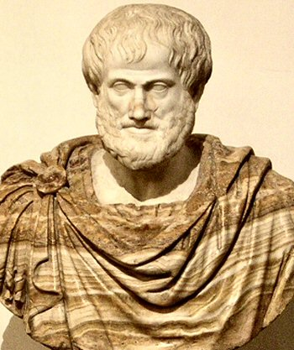
ARISTOTLE
Ethics, in the understanding of Aristotle, is a special, practical science of morality (virtue), the purpose of which is to teach a person how to become happy. Ethics should help a person to realize the main goals of his life, to solve the problem of the possibility of educating virtuous citizens in the state, therefore, along with politics, it is a very important practical science.
The Doctrine of Happiness.
Happiness is a special state of satisfaction obtained from perfect (virtuous) activity. Noting the unity of morality and happiness, Aristotle emphasized that the achievement of a state of supreme satisfaction with life depends not only on a certain organization of consciousness, but also on actions. Among the numerous conditions for happiness, the main ones are: moral and intellectual improvement, health and the availability of external goods, active citizenship, friendship.

Slide 26
The Doctrine of Virtue.
Unlike Plato, Aristotle denied the innate nature of virtues, which gave him the opportunity to pose the problem of moral education. Virtue is associated with a socially significant action, has a normative character (it is not something that is given by nature, but something that must be educated). Thus, the goal of ethics was proclaimed to be the transformation of the personality, its moral elevation. Virtues, according to Aristotle, are nurtured. But a person who is not at all predisposed to the perception of ethical knowledge will be deaf to learning. Virtue is achieved with the help of the rational part of the soul, which controls the passions (like a charioteer drives hot horses), properly directed passions do not harm morality, but are its necessary element. To be virtuous means to know a reasonable measure, the "golden mean" between extremes, one of which consists in the lack of a certain quality, and the other in its excess (so courage is the mean between cowardice and insane courage). The main virtue of the rational part of the soul is wisdom, and the intellectual and contemplative way of life, the life of a sage, is a moral ideal.

Slide 27
Ethics of the Middle Ages (10th-15th centuries)
The basis of the ethics of the Middle Ages was the Gospel – the New Testament in the biblical presentation, a new moral ideal appeared – Jesus Christ, who was an example of an ideal earthly life. According to the new ethical doctrine, the driving force of man's spiritual development is not knowledge, but his moral qualities. The development of these qualities determines the further acquisition of knowledge by a person. The teaching of Jesus Christ is based on the fact that the main driving force of every person should be love. Its highest manifestation is love for God and for one's neighbor. The qualities that determine the high spirituality of a person began to be considered mercy, compassion, the ability to repent and forgive, meekness. For the first time, the ideas of equality of all people before the laws of the Almighty were expressed Doctrine of virtues and vices: 7 deadly sins corresponded to 7 virtues: In the 21st century, the seven sins in Catholicism were added to drug addiction, excessive wealth, environmental pollution, and lies
The highest virtues are faith, hope, love
 | SINS | VIRTUES
 | pride | humility
 | cupidity | generosity
 | lust | chastity
 | envy | contentment
 | gluttony | abstinence
 | anger | serenity
 | despondency | hope

Slide 28
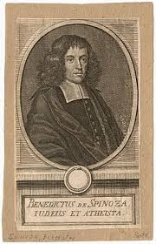
Ethics of the Modern Age (XVII-XVIII centuries) Benedict Spinoza
Man as a part of nature is subject to natural laws. In man, body and spirit are one and the same essence, a substance that has two modes: extension and thought. Spinoza considered the condition for the development of ethics to be the knowledge of bodily processes in man. He brought the method of psychology closer to the methods of mechanics and physics and reduced all the diversity of mental life to two principles – reason and affects (passions). Affect, according to B. Spinoza, expresses the state of the soul and body. All affects grow out of the desire of each to preserve his existence. Pleasures and pains are also among the main affects. The concept of affect, passion expresses the passive states of the human soul, generated by sensual, unreliable cognition. B. Spinoza calls slavery the impotence of man in the face of his passions, because they express the weakness of man, conditioned by his essence as a natural being. Every emotion ceases to be a passive state as soon as a man forms a clear and distinct idea of it, i.e., knows it. Freedom is a recognized necessity.
The ideal of the moral man is that of the sage who has risen above selfish interests and has freed himself from the suffering of trying to oppose necessity. Spinoza's rationalist methodology in the field of ethics allows him to formulate the basic requirement of moral teaching: "not to ridicule human actions, not to be upset by them, and not to curse them, but to understand them."

Slide 29
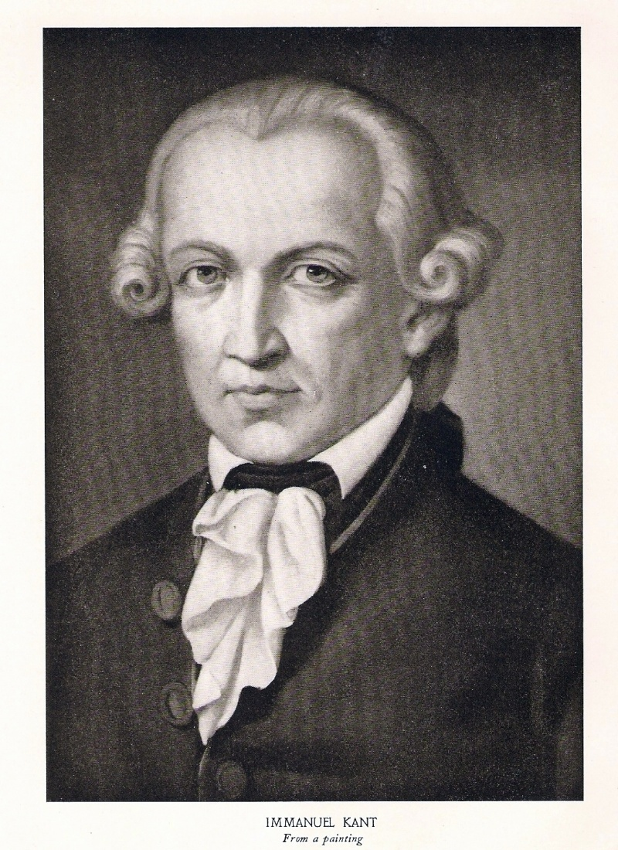
Ethics of I. Kant (1724-1804)
The central place in Kant's ethical system is occupied by the category of duty. The duty of all people to one another is to love your neighbor as yourself. Each person should "do good, i.e. help people as much as possible and promote their happiness, without hoping to receive any reward for this.’’
Kant formulates the highest moral law - the "categorical imperative". According to Kant, man is the highest value. Each person has his own dignity. He protects his dignity. But he must understand that the dignity of another person is, therefore, also the highest value. A person has the freedom to choose an action. People's actions are evaluated from the standpoint of the categories of good and evil. Is there a model, a standard of goodness in the external world? Is there a specific personality as the bearer of this standard? There is no such personality.
But why do we have an idea of good and evil? This concept is given to us from above. Our moral consciousness inevitably comes to the conclusion that there is God as a symbol of the moral ideal.
Proceeding from these two propositions (man is the highest value, and God is the symbol of the moral ideal), Kant formulates his moral law, which should regulate moral relations between people.
This law is called the categorical imperative (prescription). Its essence is as follows:
1. Act in such a way that the rule of your will can have the force of the principle of universal legislation; such a rule should apply to everyone, including you; 2. You should treat other people in the same way, what kind of attitude you expect towards your person; 3. A person should not be treated as a means to solve one's own interests.

Slide 30
5. Morality and Mores.

Slide 31
Originally, the concepts of "ethics" = "morality" = "morality" were identical and denoted the sphere of morals, customs, and generally recognized rules of behavior.
Later, they received their own content: ethics is a theory, a science;
And morality and mores are real phenomena in the life of a person and society.

Slide 32
Morality
Mores
a specific sphere of culture, in which high ideals and strict norms of behavior are concentrated and generalized, regulating the behavior and consciousness of a person in various areas of social life
principles of real practical behavior of people
the degree of assimilation of moral values of society by a person and practical adherence to them in everyday life
The World of the Due
The world of reality

Slide 33

MORALITY
(Latin mōrālis, mōrālitas – disposition, character, custom)
it is a form of social consciousness, a type of social relations, a regulator of human behavior in all spheres of social life.
The most generalized principles of morality have a social and universal significance and apply to all people without exception.

Slide 34
THE STRUCTURE OF MORALITY
MORALITY
CONSCIOUSNESS
BEHAVIOURЕ
RELATIONS
PRINCIPLES, NORMS, IDEALS

Slide 35
Levels of Moral Consciousness
Emotional level
Rational level
Moral emotions Moral Sentiments
Norms Values Moral Judgments and Ideals Categories of morality: principles, attitudes, beliefs, needs, conscience

Slide 36

The essence of morality is to ensure a balance of personal and social good, to bring harmony to the process of human communication.

Slide 37
Stages of the formation of the moral culture of the individual
elementary
Formed morality
What is it based on?
The main motive of moral behavior
Who is it typical for?
Elementary
Obedience and Imitation
Fear, fear of punishment
"What will they do to me?’’
Children Infantile adults
Conventional
Public opinion
Shame, honor "What will they think of me?’’
Adult people
Autonomous
Self-regulation
Conscience "What will I think of myself?"

